Slide 1


Christian HIRWA
February 5th , 2025

Slide 2
Outline
Executive Summary
Introduction
Methodology
Results
Conclusion
Appendix

Slide 3
Executive Summary
By use of public information, we trained a machine learning model and predict if SpaceX will reuse the first stage through various stages of data collection, visualisation and interpretation.
After the completion of our study, the results has shown an increase in success rate of launches along the years and there were some robits which were more successful compared to others.

Slide 4

Introduction
Project background and context
Space Y that would like to compete with SpaceX.
SpaceX designs, manufactures and launches advanced rockets and spacecraft.
Problems to find answers
By use of public information, we will train a machine learning model and predict if SpaceX will reuse the first stage.

Slide 5

Section 1

Slide 6
Methodology
Executive Summary
Data collection methodology:
SpaceX API
Web Scrapping from Wikipedia
Perform data wrangling
Filtering the data;
Dealing with missing values;
To name the data label based on outcome data after summarizing and analyzing features.
Perform exploratory data analysis (EDA) using visualization and SQL
Perform interactive visual analytics using Folium and Plotly Dash
Perform predictive analysis using classification models

Slide 7
Data Collection
Data sets were collected in the following processes;
To get answer from API and convert the result to json file
Cleaning data
Converting list to a data frame
Filtering the data frame and converting it to a .csv file:

Slide 8
Data Collection - Scraping
During web scraping process, we followed the following processes:
To get a response from HTML address;
To get a response from HTML address;
To find the tables of interest;
To get the columns info;
Creating a dictionary;
Appending data from all keys, converting to a dataframe and saving in .csv:

Slide 9
Data Wrangling
Regarding the data analysis process, there are several cases in which the booster did not land successfully:

Slide 10
EDA with Data Visualization
Scatter Plots
FlightNumberVS. PayloadMass;
FlightNumberVS. LaunchSite;
PayloadVS. LaunchSite;
Orbit VS. FlightNumber;
PayloadVS. Orbit Type;
Orbit VS. PayloadMassterplot.
Bar Plots
Mean VS Orbit
LinePlots
Success Rate VS Year

Slide 11
EDA with SQL
SQL queries performed:
Display the names of the unique launch sites in the space mission;
Display 5 records where launch sites begin with ‘CCA’;
Display the total payload mass carried by boosters launched by NASA;
Display the average of the amount paid by booster version F9 v1.1;
List of the dates of the first successful landing outcome;
List of the names of the boosters which have success in drone ships and have payloads between 4,000 and 6,000;
The total od number of successful and failure mission outcomes;
List of the names of the booster version which have carried the maximum payload mass;
Listing the records which will display the successful landing outcomes in the ground pad, booster versions, and launch site for the months in the year 2015;
Ranking the count of successful landing outcomes between the date 2010-06-04 and 2017-03-20.

Slide 12
Build an Interactive Map with Folium
To visualize the Launch Data into an interactive map:
Using the Latitude and Longitude Coordinates at each launch site, make a Circle Marker with a label of the name of the launch site;
Make classes 0 and 1with Green and Red, respectively;
Make circles at each launch site coordinates with labels showing launch site name.
Create objects to make it easier to understand data and all launch sites with successful and unsuccessful landings

Slide 13
Build a Dashboard with Plotly Dash
The dashboard has a dropdown, pie chart and scatters plot:
The dropdown allows to choose the launch site;
The pie chart shows the total of successful and unsuccessful launches sites selected from the dropdowns;
Scatter Graph establishing the relationship with Outcome and Payload Mass(Kg) for the different Booster Versions:
Shows the relationship between two variables;
Best to show a nonlinear pattern;
The range of data flow, maximum and minimum value, can be determined;
Observation and reading easier.

Slide 14
Predictive Analysis (Classification)
Data Preparation
Load our dataset into NumPy and Pandas;
Data transformation;
Split our data into training and test data sets.
Model Preparation
Check quantities test samples;
Decide which better type of machine learning algorithm to use.
Set parameters and algorithms to GridSearchCV;
Training GridSearchCV.
Model Evaluation
Check the accuracy of each model;
Get tuned hyperparameters for each type of algorithm.
Improving and finding the best classification model
Feature Engineering;
Algorithm Tuning;
Comparison between methods;
The model with the best accuracy score wins the best-performing model.

Slide 15
Results
Exploratory data analysis results
Interactive analytics demo in screenshots
Predictive analysis results

Slide 16

Section 2

Slide 17
Flight Number vs. Launch Site
According to the observation, there an increasing success rate on each site.

Slide 18
Payload vs. Launch Site
Literally, a heavier payload may be a consideration for a successful landing.

Slide 19
Success Rate vs. Orbit Type
The success rate increases with the number of flights for the LEO orbit while, in other orbits like GTO, it’s not related to success.

Slide 20
Flight Number vs. Orbit Type
As observed, the success rate is increasing on each site.

Slide 21
Payload vs. Orbit Type
Heavy payloads have a negative influence on GTO orbits and positive on GTO and polar LEO orbits.

Slide 22
Launch Success Yearly Trend
The success rate has increased since 2013.

Slide 23
All Launch Site Names
The DESTINCT query removes all duplicated values from the column ‘Launch-Site’.

Slide 24
Launch Site Names Begin with 'CCA'
WHERE followed by LIKE allows get the launches that contain subsisting ‘CCA’ and getting only the 5 rows using LIMIT 5.

Slide 25
Total Payload Mass
The query gives the sum of all payload where the customer is equal to NASA (CRS).

Slide 26
Average Payload Mass by F9 v1.1
WHERE clause filters the dataset to only perform calculations on Booster version F9 v1.1

Slide 27
First Successful Ground Landing Date
WHERE clause filters the dataset to only perform calculations

Slide 28
Successful Drone Ship Landing with Payload between 4000 and 6000
The query returns the booster version where landing was successfuland payload was between 4k and 6k.

Slide 29
Total Number of Successful and Failure Mission Outcomes
Using the function COUNT works out the amount.

Slide 30
Boosters Carried Maximum Payload
Using the word SELECT in the query means that it will show values in the Booster Version column from Space.

Slide 31
2015 Launch Records
DATE LIKE puts the value of 2015.

Slide 32
Rank Landing Outcomes Between 2010-06-04 and 2017-03-20
Function WHERE filters landing_outcomeand LIKE (Success or Failure; AND (DATE between) DESC means itsarranging the dataset into descending order.

Slide 33

Section 3

Slide 34
Space X in the USA
SpaceX sites

Slide 35
Labeled launch by site

Slide 36
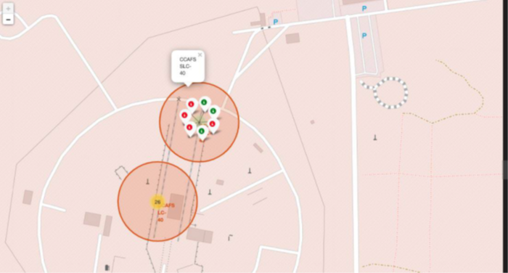
Launch Site Description
The folium map screenshot shows a launch site and its proximities such as railway, highway, coastline, with distance calculated and displayed.

Slide 37

Section 4

Slide 38
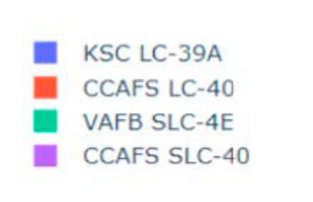
Success % per Launch Site
The KSC LC-39A had the most successful launches.

Slide 39
KSC LC 39A Launch Site
KSC LC 39A achieved a 76.9% success rate.

Slide 40
Payload vs. Launch Outcome
The success rates for low weighted payload is higher than the heavier payloads.

Slide 41

Section 5

Slide 42
Classification Accuracy
The decision tree was the best model based in the classification accuracy

Slide 43
Confusion Matrix: Decision Tree
The confusion matrix for the decision tree classifier shows that the classifier can distinguish between the classes.

Slide 44
Conclusions
The success rates for SpaceX launches increased in years;
Orbits ES L1, GEO, HEO, SSO, VLEO had the most success rate;
The Decision tree classifier is the best machine learning algorithm for this task;

Slide 45
Apendix
Github link:
https://github.com/Hirchris/Coursera-Capstone

Slide 46


